Slide 1

Intro to Pure Data
Nick Arner
nickarner.com
nicholasarner@gmail.com

Slide 2
What is it used for?
Composition (‘Solitude’)
Sound Design
Video Game Audio
Audio/Visual Performance
Augmented Instruments
Etc…
Notes:
Solitude: see download!

Slide 3
What is Pure Data?
Open-source visual programming language
Deals with:
Sound
Video
2D/3D Graphics
Interface with Sensors
Input Devices
MIDI/OSC

Slide 4
Types of Pure Data
Vanilla – “core” of PD, focus on audio and MIDI processing
Extended – Vanilla + user-wrtitten libraries, including GEM (graphics processing)

Slide 5
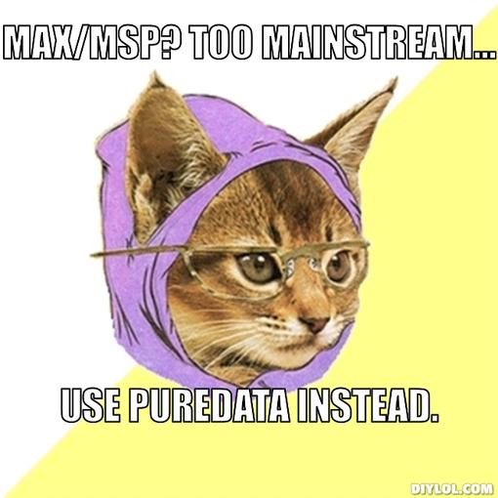
…but what about Max/MSP?
http://dm.ncl.ac.uk/sanj/2011/06/29/a-little-fun-with-puredata/

Slide 6
…but what about Max/MSP?
Pure Data is FREE and Open-Source
Embeddable
Mobile Devices (libpd)
Microcontrollers
What else?

Slide 7
History of Pure Data
Developed by Miller Puckette while at IRCAM
Branch of the “Max” patcher languages
- Named after Max Matthews
- Originally were Audio and MIDI only
Goal of PD: extend processing to other applications (video/web interaction)
Notes:
http://puredata.info/

Slide 8
Configuration
Audio Drivers
Settings
Testing, testing…

Slide 9
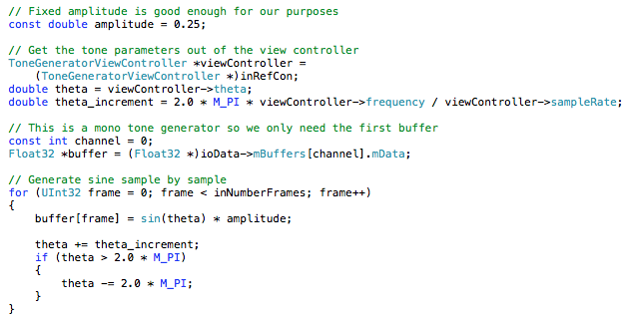
Conventional Programming

Slide 10
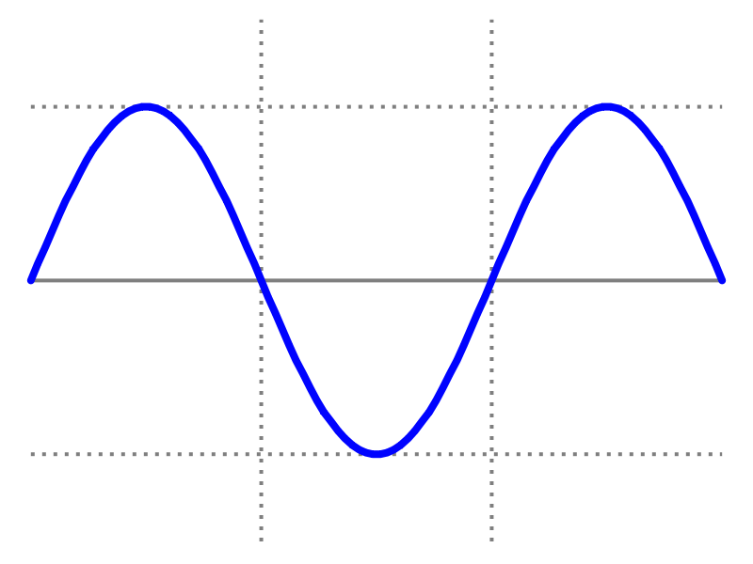
Visual Programming
Over to PD… …where we’ll make a sine-wave generator!
https://commons.wikimedia.org/wiki/File:Simple_sine_wave.svg
Notes:
-mention edit and play modes here!”
-mention Objects/Message/Number Boxes!

Slide 11
Creating Objects
Type text into boxes.
Text divided into atoms separated by white-space
First atom specifies type of object, second atom is creation arugment (how to initialize object)
“~” = “audio object”
Notes:
Show this in Sine patch

Slide 12
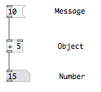
Messages, Objects, Numbers, Comments
Notes:
Show how to click “help”

Slide 13
Cables
Signal (thick)
Audio data
Control (thin)
Number data
Notes:
Show using Sine Generator example

Slide 14
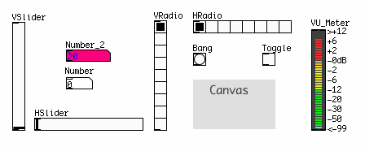
GUI Objects
http://en.flossmanuals.net/pure-data/the-interface/the-interface/
Notes:
Explain all!

Slide 15
Building A Synthesizer
Oscillators – generate tones
LFO – modulates oscillator/filter
Filter – emphesizes/removes frequencies
Envelope Generator – controls changes over a note duration (ADSR)
Amplifier – controls gain of the synth
Notes:
Use a white or chalk board if possible

Slide 16
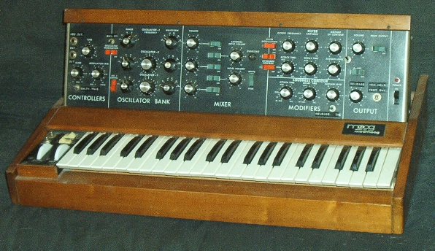
Building a Synth!
https://en.wikipedia.org/wiki/File:Minimoog.JPG

Slide 17
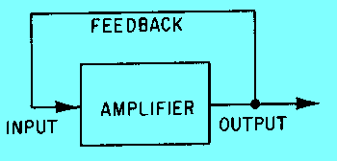
Oscillators
Sine/Cosine
Sawtooth
Square
http://www.tpub.com/neets/book9/35.htm

Slide 18
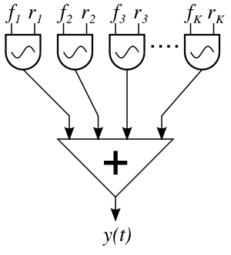
Synthesis Types
Additive
Subtractive
Filters
AM
FM
https://en.wikipedia.org/wiki/File:Additive_synthesis.svg
Notes:
LFO??

Slide 19
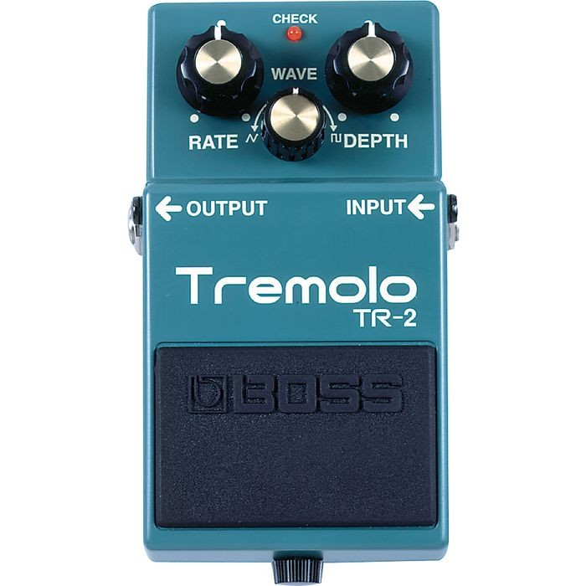
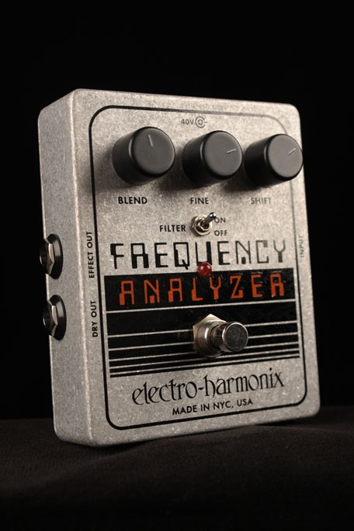
Effects
Tremolo
Ring Modulation
http://proguitarshop.com/boss-tr-2-tremolo-pedal.html
http://proguitarshop.com/electro-harmonix-frequency-analyzer-ring-modulator.html

Slide 20
ADSR
Attack
Decay
Sustain
Release

Slide 21
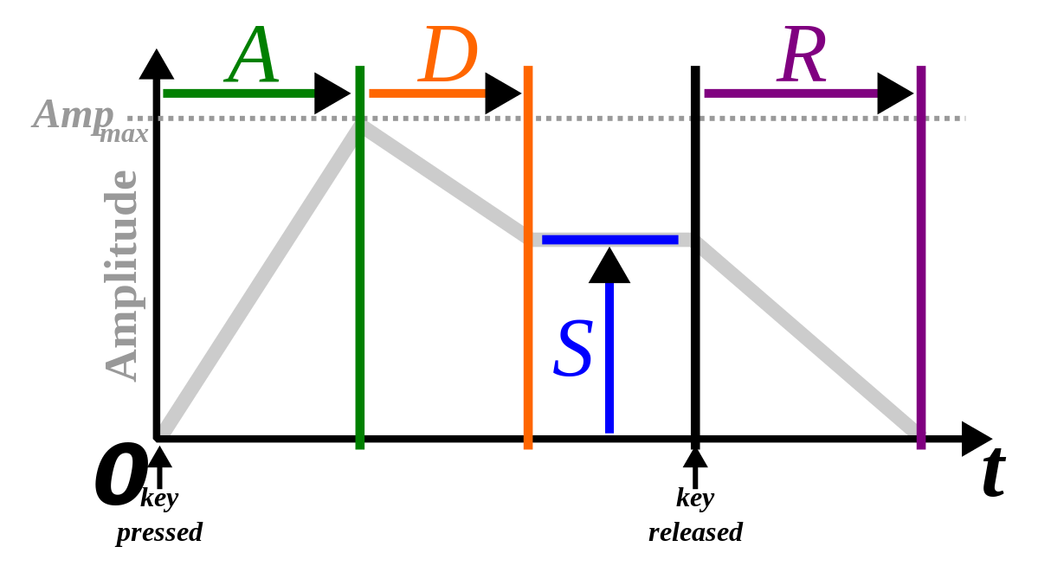
ADSR
https://en.wikipedia.org/wiki/File:ADSR_parameter.svg

Slide 22
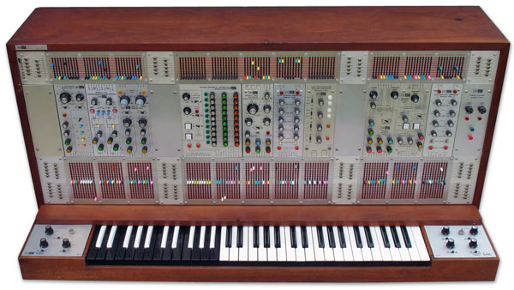
Sequencer
http://www.vintagesynth.com/arp/2500.php
Notes:
Go to “Simple Counter” Patch

Slide 23
Hot and Cold Inlets
Hot - leftmost inlet of an object
Messages to left inelts result in output messages
Cold - rightmost
Used to store single values (numbers or symbols)

Slide 24
Final Synthesizer w/Keyboard Input
Input
Oscillator
Filter
Amp

Slide 25
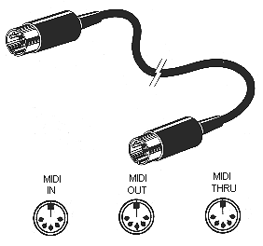
MIDI
Musical
Instrument
Digital
Interface
http://mididrumfiles.com/content/wp-content/uploads/2010/03/MIDI2.gif

Slide 26
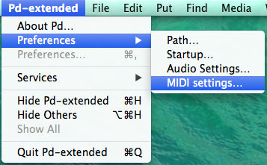
Configuration (MIDI)
What OS do you use?
OSX: PD > Preferences > MIDI Settings
Linux/Windows: Media > MIDI Settings

Slide 27
MIDI Controllers
[ctlin] object
Reads all channels as default
[notein] object
Reads in note data
Notes:
We will see these more

Slide 28
Other MIDI Objects
[pgmin] / [pgmout]
Program changes (MIDI sound)
[bendin] / [bendout]
Pitch bend information
Notes:
Put at the end?

Slide 29
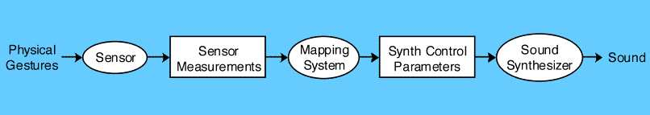
OSC
Open
Sound
Control
Specification Application Areas
Notes:
-Ethernet instead of cables

Slide 30

OSC + WiiMote
OSCulator (MAC)
GlovePIE (PC)
http://archive.roaringapps.com/app:2718

Slide 31
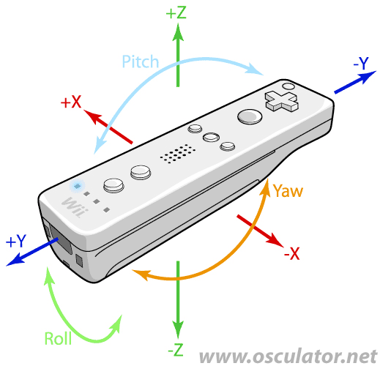
WiiMote Movement Parameters
http://www.osculator.net/doc/faq:wiimote

Slide 32
OSC + WiiMote
Make sure to turn on Bluetooth
Set parameters and type/value
PD patch: localhost 9000
More effects

Slide 33
GEM
“Graphics Environment for Multimedia”
PD Library
Included in PD-Extended
Based on OpenGL
Videopedia
Visual Recital Demo

Slide 34
GEM Setup
[gemwin] – represents window
Set frame-rate
[gemhead] – start of render chain
Moves downward
Notes:
Make sure to mention that LOTS of theoreitcal facts are being left out…(graphics programming)

Slide 35
GEM Examples
Video Playback
Camera Input
Video Mixer
Video Synthesis
VJ Set
Notes:
-Video Synthesis: Send and receive messages!!
-Keeping abstractions organised!!!

Slide 36
libpd
Based on PD-Vanilla
Links PD and mobile platforms
Java (Android) and Objective-C (iOS)
Download

Slide 37
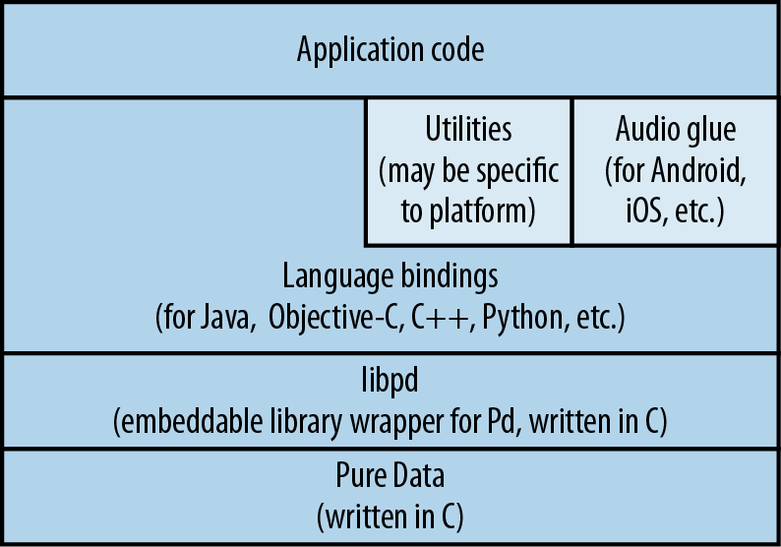
libpd

Slide 38
libpd

Slide 39

libpd
…Here’s an example!

Slide 40

Arduino
http://arduino.cc/en/uploads/Main/ArduinoUno_R3_Front.jpg
Notes:
Show, then explain/answer questions

Slide 41
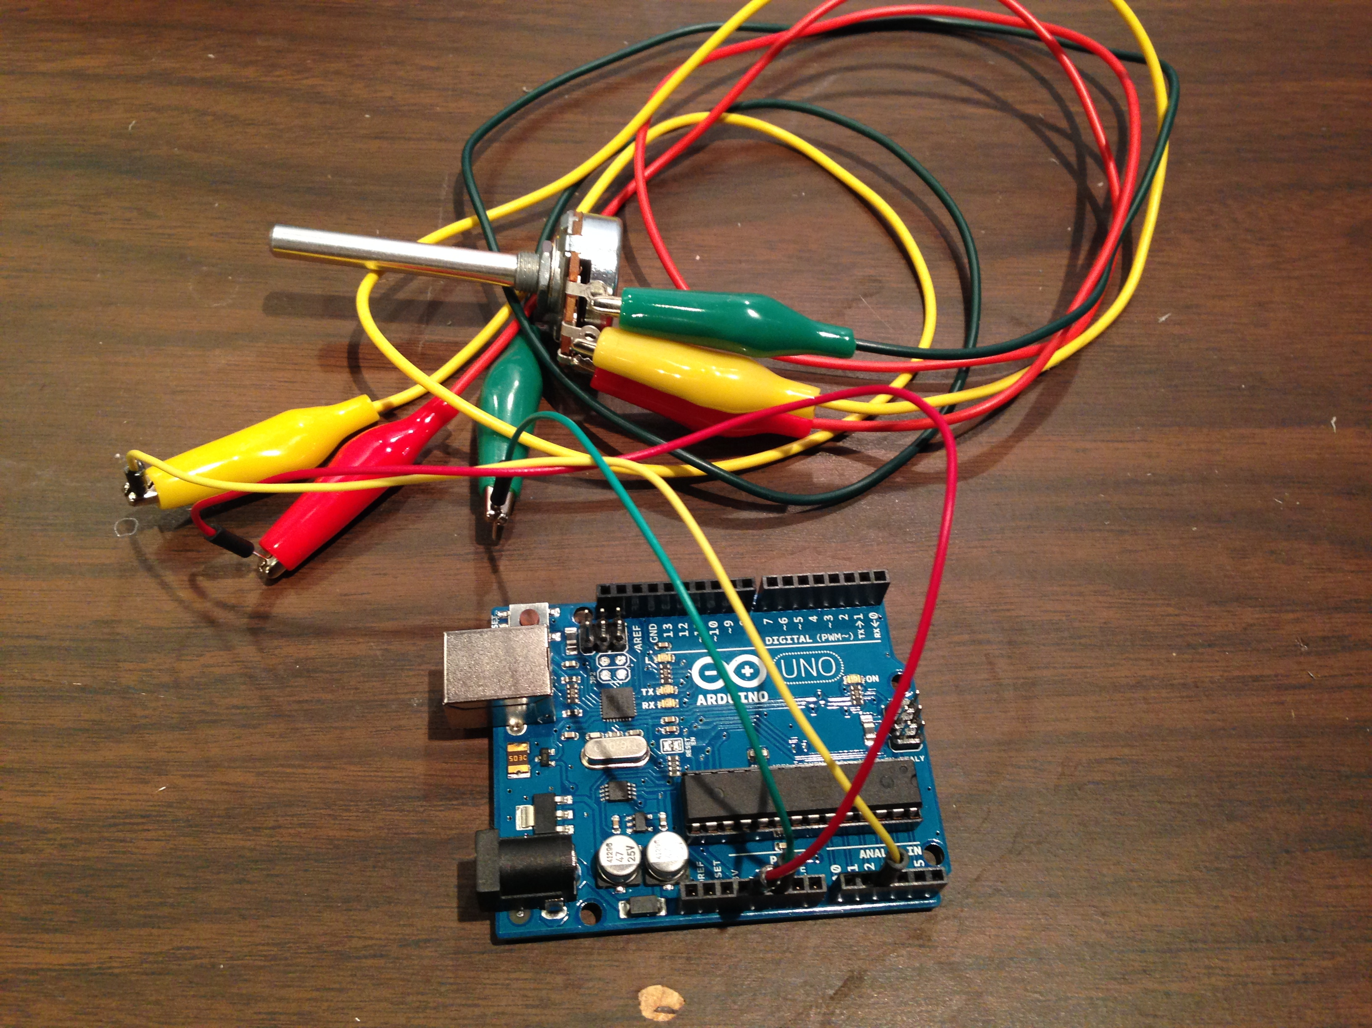
Our Circuit

Slide 42
Setting Up
Download pduino
FIRMATA – firmware protocol
Already included in Aruino download
Wiring
Set up correct port
Detailed tutorial
Notes:
Show synth, then Ableton Live

Slide 43
Best Practices
Dataflow should be vertical
Comments necessary if collaborating
Modularization
CAN Article

Slide 44
Sub-Patching
Help with organisation
Can be copied
Can have inlets (~) and outlets (~)
Notes:
Demonstrate osc~ as a subpatch

Slide 45
Abstractions
Reusable code
Where to save them?
Open by making an instance in an object box
Notes:
Show using “video-synth” patch

Slide 46
Further Resources
The “Help” Browser
FLOSS Manual
“Programming Electronic Music in PD”
“The Theory and Technique of Electronic Music”
Andy Farnell’s site
Mailing List

